Slide 1
Computer Networks (CS-241)
Dr Syed Muhammad Mohsin
Department of Computer Science,
University of Wah
Adapted From:
Computer Networking: A Top-Down Approach 8th edition: Jim Kurose, Keith Ross Pearson, 2020

Slide 2
Recapitulation: Layered TCP/IP stack (1/3)
application: supporting network applications
HTTP, IMAP, SMTP, DNS
transport: process-process data transfer
TCP, UDP
network: routing of datagrams from source to destination
IP, routing protocols
link: data transfer between neighboring network elements
Ethernet, 802.11 (WiFi), PPP
physical: bits “on the wire”
application
application
transport
transport
network
network
link
link
physical
physical

Slide 3

Recapitulation: Services, Layering and Encapsulation (2/3)
application
transport
network
link
physical
M
application
transport
network
link
physical
M
message
H_{t}
M
H_{t}
M
segment
H_{n}
H_{t}
M
H_{n}
H_{t}
M
datagram
H_{l}
H_{n}
H_{t}
M
H_{l}
H_{n}
H_{t}
M
frame
source
destination

Slide 4
Recapitulation: Application layer (3/3)
The Application Layer is the topmost layer of the OSI (Open Systems Interconnection) model. It provides services and interfaces that allow end users and applications to access the network. Key responsibilities of application layer are mentioned below.
Network services for applications: Provides protocols and services for user-level network interactions.
Data formatting and translation: Converts data from application formats into network formats (and vice versa).
Resource sharing and remote access: Allows sharing of files, printers, and other network resources.
User authentication and privacy: Supports security features such as logins, encryption, and session control.

Slide 5
Transport layer: overview
Our goal:
understand principles behind transport layer services:
multiplexing, demultiplexing
reliable data transfer
flow control
congestion control
learn about Internet transport layer protocols:
UDP: connectionless transport
TCP: connection-oriented reliable transport
TCP congestion control

Slide 6

Transport layer: roadmap
Transport-layer services
Connectionless transport: UDP
Principles of reliable data transfer
Connection-oriented transport: TCP
Principles of congestion control
TCP congestion control
Evolution of transport-layer functionality

Slide 7
















Transport services and protocols
application
transport
network
data link
physical
provide logical communication between application processes running on different hosts
mobile network
national or global ISP
transport protocols actions in end systems:
sender: breaks application messages into segments, passes to network layer
receiver: reassembles segments into messages, passes to application layer
logical end-end transport
local or regional ISP
home network
content
provider
network
application
transport
network
data link
physical
datacenter
network
two transport protocols available to Internet applications
TCP, UDP
enterprise
network
Notes:
By logical communication, we mean that from an application’s perspective, it is as if the hosts running the processes were directly connected; in reality, the hosts may be on opposite sides of the planet, connected via numerous routers and a wide range of link types. Application processes use the logical communication provided by the transport layer to send messages to each other, free from the worry of the details of the physical infrastructure used to carry these messages.
Let’s look at each of these three (logical communications, actions,

Slide 8
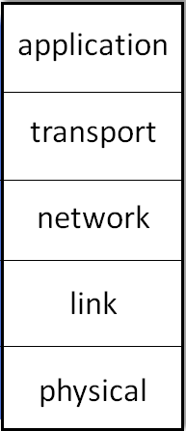
Transport services and protocols
The Transport Layer provides communication between processes running on different hosts. It sits above the Network Layer.
Services of Transport layer
Process-to-process delivery: Network layer provides host-to-host delivery, but transport layer delivers data to the correct application (e.g., browser, email, video call).
Multiplexing and De-multiplexing:
Multiplexing: The transport layer collects data from multiple applications, adds transport layer headers (with port numbers), and passes them to the network layer as separate segments. This allows many applications to share the same network connection.
De-multiplexing: The transport layer receives segments from the network layer, checks the destination port numbers, and delivers each segment to the correct application process (e.g., web browser, email, etc.).

Slide 9
Transport services and protocols
3. Error control: Detects corrupted data using checksums (error-detection technique used to ensure data integrity during transmission).
4. Reliable data transfer (in reliable protocols):
Ensures data arrives without loss, without duplication, and in order.
Flow control: Prevents sender from overwhelming the receiver.
Congestion control: Prevents the network from being overloaded.
Transport Layer Protocols:
UDP (User Datagram Protocol) – unreliable, no connection.
TCP (Transmission Control Protocol) – reliable, connection-oriented.
Notes:
Example (simplified):
Data: 10, 20, 30 → Sum = 60 → Checksum = 60
Receiver adds 10 + 20 + 30 = 60 → compares with checksum 60 (no error).
If the sum doesn’t match, it means the data was corrupted in transit.

Slide 10
Transport vs. network layer services and protocols
Network layer: logical communication between hosts
No guarantee of timing, order, or reliability. IP protocol works here.
Transport layer: logical communication between processes
Builds additional features on top of IP:
reliability (TCP)
flow control
congestion control
Transport layer depends on network layer for routing and delivery, but does not rely on it for reliability.
household analogy:
12 kids in Mr. X’s house sending letters to 12 kids in Mr. Y’s house:
hosts = houses
processes = kids
app messages = letters in envelopes
transport protocol = Ann and Bill who demux to in-house siblings
network-layer protocol = postal service
Notes:
Network layer: delivers packets between hosts (host-to-host).
Transport layer: delivers data between processes (process-to-process).

Slide 11
Transport Layer Actions
Sender:
application
application
passed an application-layer message
app. msg
determines segment header fields values
T_{h}
transport
app. msg
transport
T_{h}
creates segment
network (IP)
network (IP)
passes segment to IP
link
link
physical
physical

Slide 12
Transport Layer Actions
Receiver:
application
receives segment from IP
application
checks header values
transport
transport
app. msg
extracts application-layer message
network (IP)
network (IP)
demultiplexes message up to application via socket
link
link
physical
physical
app. msg
T_{h}

Slide 13
Overview of the Transport Layer in the Internet
Feature | Description
Layer Position | It is the 4th layer in the TCP/IP model (between the Application Layer and Network Layer).
Main Function | Provides end-to-end communication between processes (applications) running on different hosts.
Purpose | Ensures that data is delivered reliably, in order, and to the correct application on the receiving device.
Key Tasks / Functions | • Segmentation and Reassembly – Divides large data from applications into smaller segments and reassembles them at the receiver. • Multiplexing and Demultiplexing – Uses port numbers to manage multiple application connections simultaneously. • Connection Control – Establishes, maintains, and terminates logical connections. • Flow Control – Prevents a fast sender from overwhelming a slow receiver. • Error Control (Checksum) – Detects and sometimes corrects transmission errors.
Main Protocols | TCP (Transmission Control Protocol) – Reliable, connection-oriented communication (used for web, email, file transfer).UDP (User Datagram Protocol) – Unreliable, connectionless communication (used for streaming, gaming, VoIP).
Addressing | Uses Port Numbers (e.g., port 80 for HTTP, 25 for SMTP) to identify specific application processes.
Examples of Services | • Sending an email (SMTP over TCP) • Viewing a webpage (HTTP over TCP) • Video calling or streaming (RTP over UDP)

Slide 14
Two principal Internet transport protocols
application
transport
network
data link
physical
TCP: Transmission Control Protocol
reliable, in-order delivery
congestion control
flow control
connection setup
UDP: User Datagram Protocol
unreliable, unordered delivery
no-frills extension of “best-effort” IP
services not available:
delay guarantees
bandwidth guarantees
mobile network
national or global ISP
logical end-end transport
local or regional ISP
home network
content
provider
network
application
transport
network
data link
physical
datacenter
network
enterprise
network

Slide 15
Chapter 3: roadmap
Transport-layer services
Connectionless transport: UDP
Principles of reliable data transfer
Connection-oriented transport: TCP
Principles of congestion control
TCP congestion control
Evolution of transport-layer functionality

Slide 16
UDP: User Datagram Protocol
UDP provides the minimum transport-layer functionality. It does not add extra features like reliability or flow control.
UDP provides best effort delivery, meaning: It tries to deliver data, but makes no guarantees.
UDP does not ensure reliability, ordering, or protection against duplication.
Skype, WhatsApp Calls, YouTube Live, Netflix, Multicast, DNS, DHCP, RIP etc.
Why is there a UDP?
no connection establishment (which can add RTT delay)
simple: no connection state at sender, receiver
small header size
no congestion control
UDP can blast away as fast as desired!
can function in the face of congestion
connectionless:
no handshaking between UDP sender, receiver
each UDP segment handled independently of others

Slide 17
UDP: User Datagram Protocol
UDP use:
streaming multimedia apps (loss tolerant, rate sensitive)
DNS
SNMP
HTTP/3
if reliable transfer needed over UDP (e.g., HTTP/3):
add needed reliability at application layer
add congestion control at application layer

Slide 18
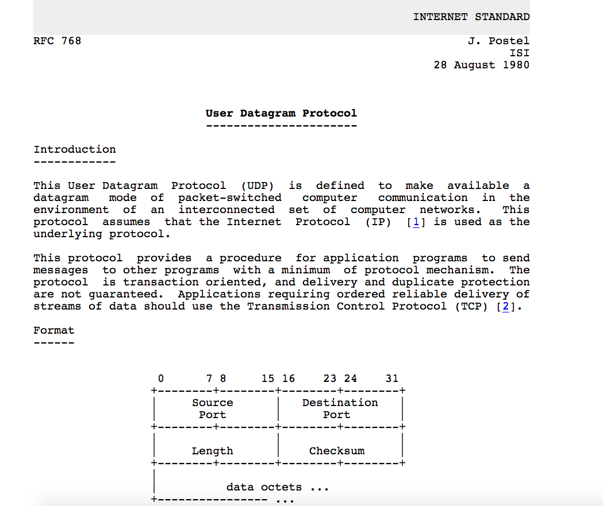
UDP: User Datagram Protocol [RFC 768]
Notes:
read this RFC – it’s only 2.5 pages!

Slide 19
UDP: Transport Layer Actions
SNMP client
SNMP server
application
application
transport
(UDP)
transport
(UDP)
network (IP)
network (IP)
link
link
physical
physical

Slide 20
UDP: Transport Layer Actions
SNMP client
SNMP server
UDP sender actions:
application
application
passed an application-layer message
SNMP msg
transport
(UDP)
transport
(UDP)
determines UDP segment header fields values
UDP_{h}
SNMP msg
UDP_{h}
creates UDP segment
network (IP)
network (IP)
passes segment to IP
link
link
physical
physical
SNMP (Simple Network Management Protocol)

Slide 21
UDP: Transport Layer Actions
SNMP client
SNMP server
UDP receiver actions:
application
receives segment from IP
application
checks UDP checksum header value
transport
(UDP)
transport
(UDP)
SNMP msg
extracts application-layer message
network (IP)
network (IP)
SNMP msg
UDP_{h}
demultiplexes message up to application via socket
link
link
physical
physical

Slide 22
UDP segment header
32 bits
source port #
dest port #
length
checksum
application
data
(payload)
length, in bytes of UDP segment, including header
data to/from application layer
UDP segment format

Slide 23

UDP checksum
Goal: detect errors (i.e., flipped bits) in transmitted segment
1st number
2nd number
sum
Transmitted: 5 6 11
Received: 4 6 11
receiver-computed
checksum
=
sender-computed
checksum (as received)

Slide 24
UDP checksum
Goal: detect errors (i.e., flipped bits) in transmitted segment
sender:
treat contents of UDP segment (including UDP header fields and IP addresses) as sequence of 16-bit integers
checksum: addition (one’s complement sum) of segment content
checksum value put into UDP checksum field
receiver:
compute checksum of received segment
check if computed checksum equals checksum field value:
Not equal - error detected
Equal - no error detected. But maybe errors nonetheless? More later ….

Slide 25
Summary: UDP
“no frills” protocol:
segments may be lost, delivered out of order
best effort service: “send and hope for the best”
UDP has its plusses:
no setup/handshaking needed (no RTT incurred)
can function when network service is compromised
helps with reliability (checksum)
build additional functionality on top of UDP in application layer (e.g., HTTP/3)

Slide 26
Chapter 3: roadmap
Transport-layer services
Connectionless transport: UDP
Principles of reliable data transfer
Connection-oriented transport: TCP
Principles of congestion control
TCP congestion control
Evolution of transport-layer functionality

Slide 27
Principles of reliable data transfer
sending process
receiving process
application
data
data
transport
reliable channel
reliable service abstraction
Notes:
note arrows through reliable data transfer channel is just one way – reliably send from sender to receiver

Slide 28
Principles of reliable data transfer
sending process
receiving process
sending process
receiving process
application
data
data
application
data
data
transport
transport
reliable channel
sender-side of
reliable data transfer protocol
receiver-side
of reliable data transfer protocol
reliable service abstraction
transport
network
unreliable channel
reliable service implementation
Notes:
Spend some time talking about how its to the sender and receiver side protocol that IMPLEMENTS reliable data transfer
Communication over unreliable channel is TWO-way: sender and receiver will exchange messages back and forth to IMPLEMENT one-way reliable data transfer

Slide 29
Principles of reliable data transfer
sending process
receiving process
application
data
data
transport
sender-side of
reliable data transfer protocol
receiver-side
of reliable data transfer protocol
Complexity of reliable data transfer protocol will depend (strongly) on characteristics of unreliable channel (lose, corrupt, re-order data?)
transport
network
unreliable channel
reliable service implementation
Notes:
So we have a sender side and a receiver side. How much work they’ll have to do depends on the IMPAIRMENTS introduced by channel – if the channel is perfect – no problem!

Slide 30
Principles of reliable data transfer
sending process
receiving process
application
data
data
transport
sender-side of
reliable data transfer protocol
receiver-side
of reliable data transfer protocol
Sender, receiver do not know the “state” of each other, e.g., was a message received?
unless communicated via a message
transport
network
unreliable channel
reliable service implementation
Notes:
Here’s a point of view to keep in mind – it’s easy for US to look at sender and receiver together and see what is happening. OH – that message sent was lost.
But think about it say from senders POV How does the sender know if its transmitted message over the unreliable channel got though?? ONLY if receiver somehow signals to the sender that it was received.
The key point here is that one side does NOT know what is going on at the other side – it’s as if there’s a curtain between them. Everything they know about the other can ONLY be learned by sending/receiving messages.
Sender process wants to make sure a segment got through. But it can just somehow magically look through curtain to see if receiver got it. It will be up to the receiver to let the sender KNOW that it (the receiver) has correctly received the segment.
How will the sender and receiver do that – that’s the PROTOCOL.
Before starting to develop a protocol, let’s look more closely at the interface (the API if you will)

Slide 31
Reliable data transfer (rdt) protocol: interfaces
rdt_send(): called from above, (e.g., by app.). Passed data to deliver to receiver upper layer
deliver_data(): called by rdt to deliver data to upper layer
sending process
receiving process
rdt_send()
data
data
deliver_data()
data
sender-side
implementation of rdt reliable data transfer protocol
receiver-side
implementation of rdt reliable data transfer protocol
packet
udt_send()
Header
data
Header
data
rdt_rcv()
unreliable channel
udt_send(): called by rdt
to transfer packet over
unreliable channel to receiver
rdt_rcv(): called when packet arrives on receiver side of channel
Bi-directional communication over unreliable channel

Slide 32
Principles of Reliable Data Transfer in UDP and Protocols
UDP itself does not provide reliability, but applications can build reliability on top of UDP.
Kurose & Ross introduce RDT protocols to explain how reliability is achieved using:
Checksums: detect errors
Sequence numbers: detect lost or duplicate packets
ACKs: acknowledgments from receiver
Timers: to re-transmit lost packets

Slide 33
Reliable data transfer (rdt): getting started
We will:
incrementally develop sender, receiver sides of reliable data transfer protocol (rdt).
consider only unidirectional data transfer
but control info will flow in both directions!
use finite state machines (FSM) to specify sender, receiver
event causing state transition
actions taken on state transition
state: when in this “state” next state uniquely determined by next event
state
1
state
2
event
actions
Notes:
SO let’s get started in developing our reliable data transfer protocol, which we’ll call rdt (need a good acronym for protocol – like HTTP, TCP, UDP, IP)
Bullet points 1 and 2
NOW if we are going to develop a protocol, so we’ll need some way to SPECIFY a protocol. How do we do that?
We could write text, but as all know, that’s prone to misinterpretation, and might be incomplete. You might write a specification, and then think “oh yeah – I forgot about that case”
What we need is more formal way to specify a protocol. In fact, with a formal specification there may be ways to PROVE PROPERTIES about a specification. But that’s an advanced topic we won’t get into here. We’ll start here by adopting a fairly simple protocol specification technique known as finite state machines (FSM)
And as the name might suggest, a central notion of finite state machines is the notion of STATE
<talk about state>

Slide 34
rdt1.0: reliable transfer over a reliable channel
Assumptions: No bit errors, No packet losses, No packet duplication, No delays.
Sender: Takes data from upper layer and Sends it directly to receiver.
Receiver: Reads data Delivers to upper layer
No need for ACK, NAK (Negative Acknowledgment), Sequence numbers and Timers
Very simple model. Everything works perfectly. Not realistic.
separate FSMs for sender, receiver:
sender sends data into underlying channel
receiver reads data from underlying channel
Wait for call from above
rdt_send(data)
Wait for call from below
rdt_rcv(packet)
sender
packet = make_pkt(data)
udt_send(packet)
receiver
extract (packet,data)
deliver_data(data)
Notes:
We’ll start with the simplest case possible - an unreliable channel that is, in fact perfect – no segments are lost, corrupted, duplicated or re-ordered. The sender just sends and it pops out the other side(perhaps after some delay) perfectly.

Slide 35
rdt2.0: channel with bit errors
Packets can get bit errors during transmission.
Example: 01010110 → 01000110
Sender behavior:
Sends a packet
Waits for ACK/NAK
If ACK → send next packet
If NAK → retransmit
Receiver behavior:
Checks checksum
If OK → send ACK
If corrupted → send NAK

Slide 36
rdt2.0: channel with bit errors
underlying channel may flip bits in packet
checksum to detect bit errors
the question: how to recover from errors?
acknowledgements (ACKs): receiver explicitly tells sender that pkt received OK
negative acknowledgements (NAKs): receiver explicitly tells sender that pkt had errors
sender retransmits pkt on receipt of NAK
stop and wait
sender sends one packet, then waits for receiver response

Slide 37
rdt2.0: FSM specification
rdt_send(data)
snkpkt = make_pkt(data, checksum)
udt_send(sndpkt)
rdt_rcv(rcvpkt) &&
isNAK(rcvpkt)
sender
Wait for call from above
Wait for ACK or NAK
isNAK(rcvpkt)
udt_send(sndpkt)
rdt_rcv(rcvpkt) && corrupt(rcvpkt)
udt_send(NAK)
rdt_rcv(rcvpkt) && isACK(rcvpkt)
isACK(rcvpkt)
Wait for call from below
Λ
receiver
Note: “state” of receiver (did the receiver get my message correctly?) isn’t known to sender unless somehow communicated from receiver to sender
that’s why we need a protocol!
rdt_rcv(rcvpkt) && notcorrupt(rcvpkt)
extract(rcvpkt,data)
deliver_data(data)
udt_send(ACK)

